Slide 1
Resolution in the Predicate Calculus

Slide 2
Outline
Unification
Predicate-Calculus Resolution
Completeness and Soundness
Converting Arbitrary wffs to Clause Form
Using Resolution to Prove Theorems
Answer Extraction

Slide 3
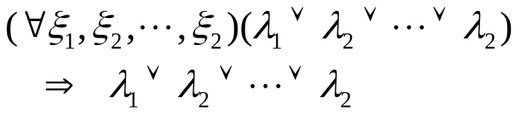

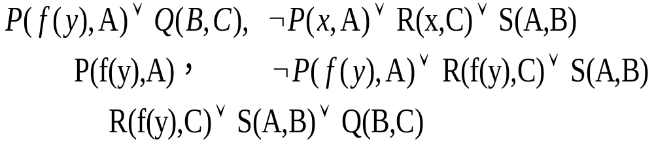
Unification
Simply dropping the universal quantifiers and assuming universal quantification of any variables in the scope
Clauses: WFFs in the abbreviated form
If two clauses have matching but complementary literals, it is possible to resolve them
  Example:

Slide 4
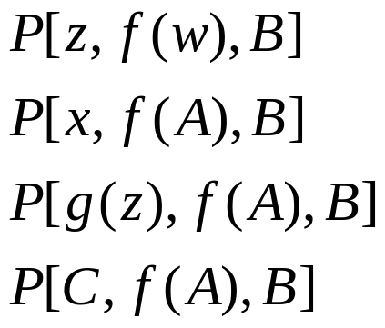

Unification
Unification: A process that computes the appropriate substitution
Substitution instance of an expression is obtained by substituting terms for variables in that expression.
  Four substitution instances
  The first instance --- alphabetic variant.
  The last of the four different variables is called a ground instance (A ground term is a term that contains no variables).

Slide 5
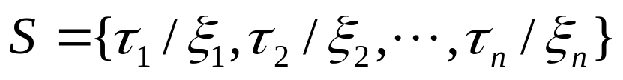
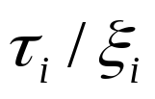


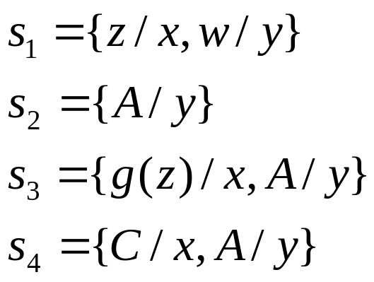

Unification
Any substitution can be represented by a set of ordered pairs
  The pair means that term is substituted for every occurrence of the variable throughout the scope of the substitution.
  No variable can be replaced by a term containing that same variable.

Slide 6

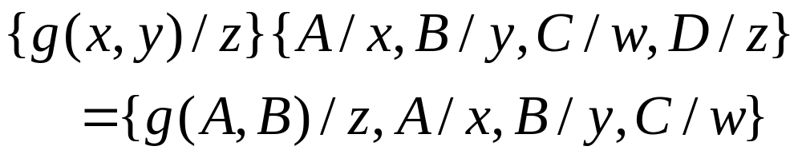
Unification
  ws denotes a substitution instance of an expression w, using a substitution s.
  Example
  The composition s1 and s2 is denoted by s1 s2, which is that substitution obtained by first applying s2 to the terms of s1 and then adding any pairs of s2 having variables not occurring among the variables of s1. Thus,

Slide 7
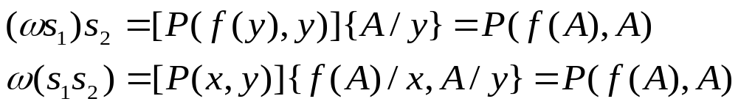
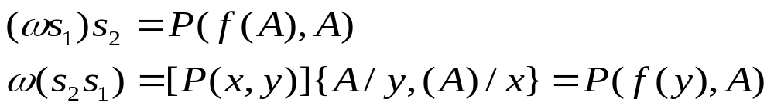
Unification
Associative
  Let w be P(x,y), s1 be {f(y)/x}, and s2 be {A/y}
  Substitutions are not commutative, in general

Slide 8
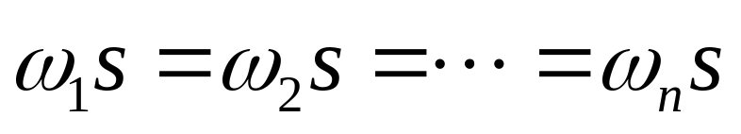
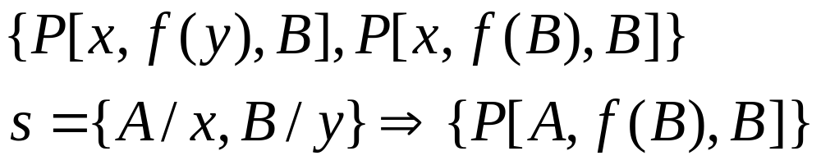
Unification
Unifiable: a set of expressions is unifiable if there exists a substitution s such that
For Example:

Slide 9




Unification
MGU (Most general (or simplest) unifier) has the property that if s is any unifier of yielding , then there exists a substitution such that . Furthermore, the common instance produced by a most general unifier is unique except for alphabetic variants.
UNIFY
  Can find the most general unifier of a finite set of unifiable expressions and that report failure when the set cannot be unified.
  Basis to UNIFY is the idea of a disagreement set.
    The disagreement set of a nonempty set W of expressions is obtained by locating the first symbol at which not all the expressions in W have exactly the same symbol, and then extracting from each expression in W the subexpression that begins with the symbol occupying that position.

Slide 10












Unification
UNIFY( ) ( is a set of list-structured expressions.)
(Initialization step; is the empty substitution. )
If is a singleton, exit with , the mgu of . Otherwise, continue.
the disagreement set of .
If there exists elements and in such that is a variable that does not occur in , continue. Otherwise, exit with failure: is not Unifiable.
{note that }
.
Go to step 2

Slide 11









Predicate-Calculus Resolution
are two clauses. Atom in and a literal in such that and have a most general unifier , then these two clauses have a resolvent, . The resolvent is obtained by applying the substitution to the union of and , leaving out the complementary literals.
Examples:

Slide 12
Completeness and Soundness
Predicate-calculus resolution is sound
  If ρ is the resolvent of two clauses φ and ψ, then {φ, ψ}|= ρ
Completeness of resolution
  It is impossible to infer by resolution alone all the formulas that are logically entailed by a given set.
  In propositional resolution, this difficulty is surmounted by using resolution refutation.

Slide 13
Converting wffs to Clause Form
1. Eliminate implication signs.
2. Reduce scopes of negation signs.
3. Standardize variables
  Since variables within the scopes of quantifiers are like “dummy variables”, they can be renamed so that each quantifier has its own variable symbol.
4. Eliminate existential quantifiers.

Slide 14
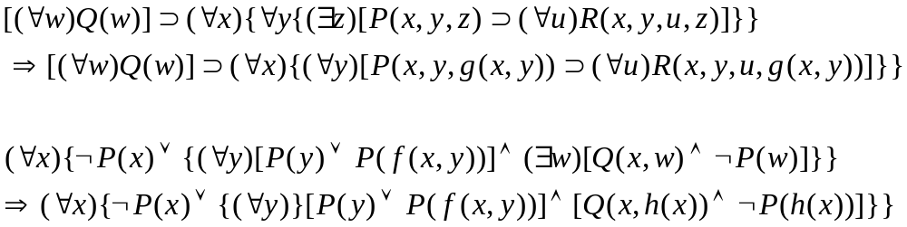
Converting wffs to Clause Form
  Skolem function, Skolemization:
  Replace each occurrence of its existentially quantified variable by a Skolem function whose arguments are those universally quantified variables
  Function symbols used in Skolem functions must be “new”.

Slide 15

Converting wffs to Clause Form
  Skolem function of no arguments
  Skolem form: To eliminate all of the existentially quantified variables from a wff, the preceding procedure on each subformula is used in turn. Eliminating the existential quantifiers from a set of wffs produces what is called the Skolem form of the set of formulas.
  The skolem form of a wff is not equivalent to the original wff. .
  What is true is that a set of formulas,  is satisfiable if and only if the Skolem form of  is. Or more usefully for purpose of resolution refutations,  is unsatisfiable if and only if the Skolem form of  is unsatifiable.

Slide 16
Converting wffs to Clause Form
5. Convert to prenex form
  At this stage, there are no remaining existential quantifiers, and each universal quantifier has its own variable symbol.
  A wff in prenex form consists of a string of quantifiers called a prefix followed by a quantifier-free formula called a matrix. The prenex form of the example wff in slide 14
6. Put the matrix in conjunctive normal form
  The matrix of the preceding example wff is put in conjunctive normal form

Slide 17


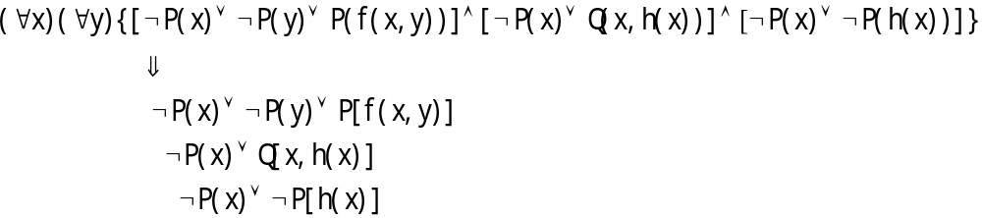
Converting Arbitrary wffs to Clause Form
7. Eliminate universal quantifiers
  Assume that all variables in the matrix are universally quantified.
8. Eliminate ∧ symbols
  The explicit occurrence of ∧ symbols may be eliminated by replacing expressions of the form with the set of wffs .

Slide 18
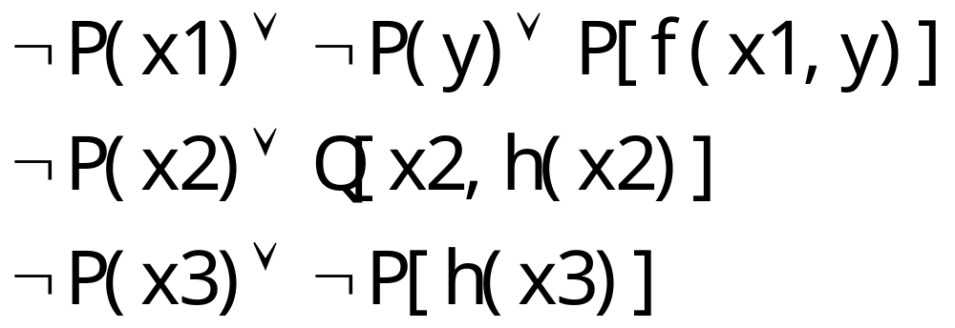
Converting Arbitrary wffs to Clause Form
9. Rename variables
  Variable symbols may be renamed so that no variable symbol appears in more than one clause .

Slide 19
Using Resolution to Prove Theorem
To prove wff ω from Δ, proceed just as in the propositional calculus.
  1. Negate ω,
  2. Convert this negation to clause form, and
  3. Add it to the clause form set of Δ.
  4. Then apply resolution until the empty clause is deduced.

Slide 20
Using Resolution to Prove Theorem
Problem: the package delivery robot.
Suppose this robot knows that all of the packages in room 27 are smaller than any of the ones in room 28.
  Suppose that the robot knows the following:
  3. P(A)
  4. P(B)
  5. I(A,27)∨I(A,28) // package A is either in room 27 or in room 28
  6. I(B,27) // package B is in room 27
  7. ¬S(B,A) // package B is not smaller than package A.

Slide 21
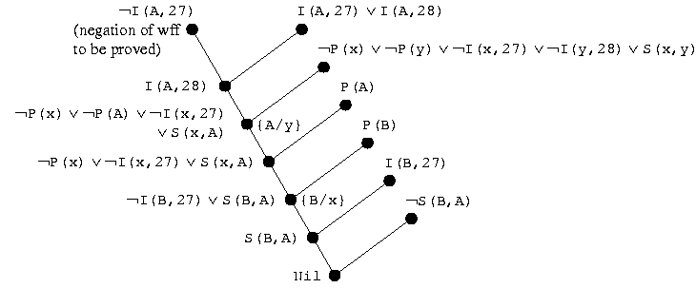
Using Resolution to Prove Theorem

Slide 22
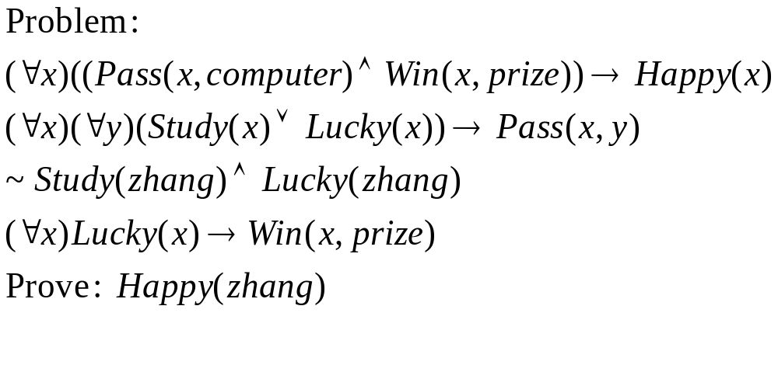
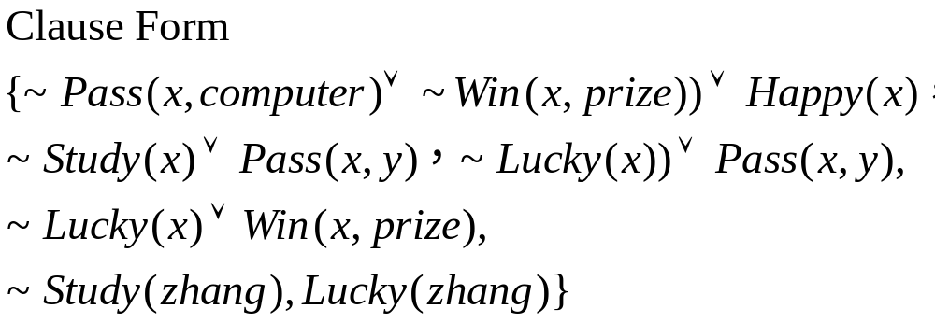
Example

Slide 23
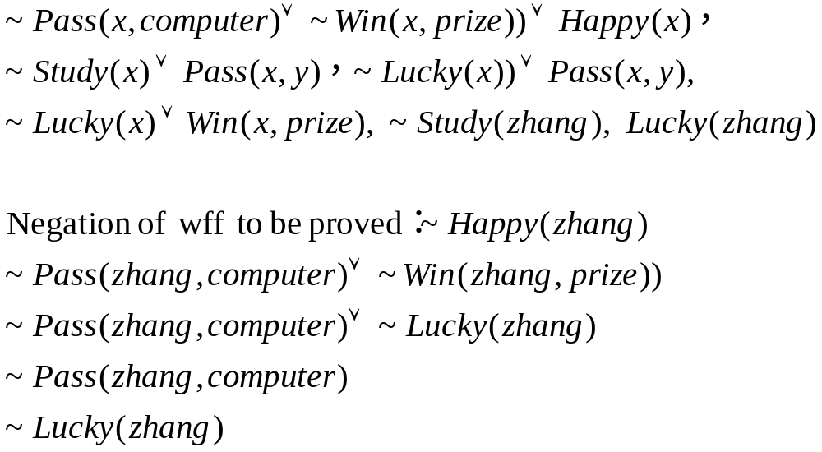
Example

Slide 24
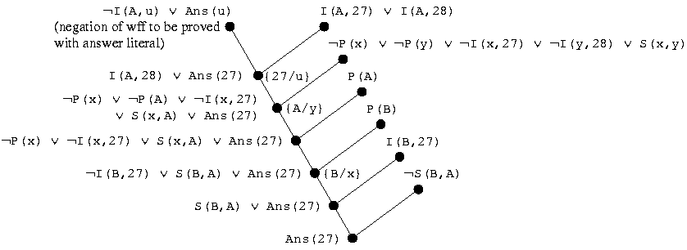
Answer Extraction

Slide 25
Summary
Unification
Predicate-Calculus Resolution
Converting Arbitrary wffs to Clause Form
Using Resolution to Prove Theorems
Answer Extraction
Problems:
  Search strategy is slow
  Knowledge consistence
  ……

